Slide 1
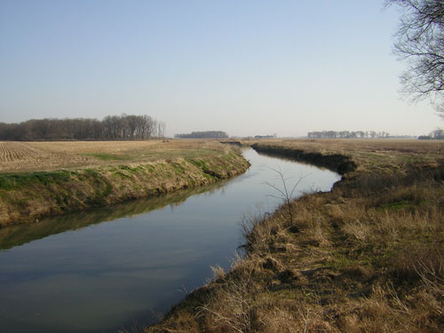
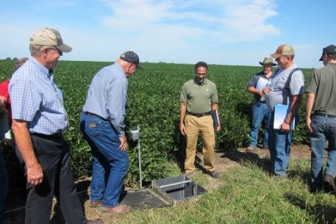
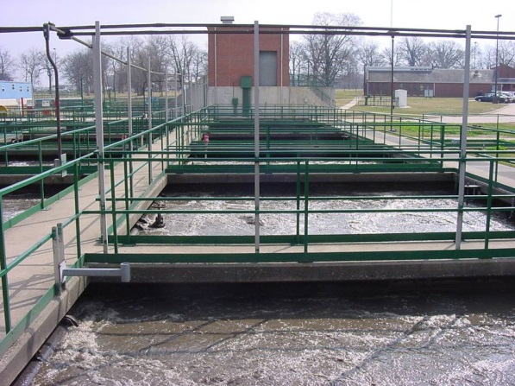
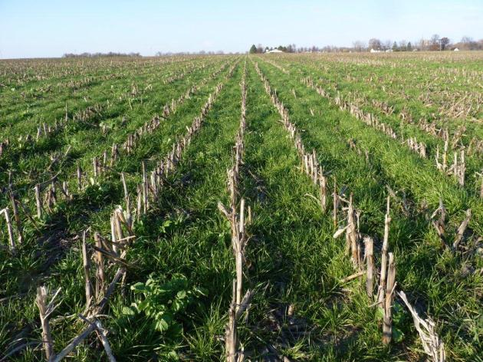
Science Assessment to Support an Illinois Nutrient Reduction Strategy
Mark David, George Czapar,
Greg McIsaac, Corey Mitchell
August 8, 2013
11-08-12

Slide 2
Technical Tasks
develop a science based technical assessment of:
  current conditions in Illinois of nutrient sources and export by rivers in the state from point and non-point sources
  methods that could be used to reduce these losses and estimates of their effectiveness throughout Illinois
  estimates of the costs of statewide and watershed level application of these methods to reduce nutrient losses to meet TMDL and Gulf of Mexico goals

Slide 3
Steps we will take
determine current conditions
identify critical watersheds
estimate potential reductions and costs
develop scenarios

Slide 4
1. Current Conditions
nutrient (nitrate and total P) loads from major river basins of Illinois
  estimates of point and non-point sources
  compare 1980-1996 with 1997-2011
  determine direction of loads
determine current agricultural management practices across the state
  nutrient inputs and management (fertilizers and manure)
  current cropping practices
  N and P loads and yields from water quality data
Notes:
Water is here for a few hours.

Slide 5
Point Source P Analysis
began with IEPA’s total P analysis
  USEPA nutrient loading tool that is linked to the Integrated Compliance Information System (ICIS)
  focused on larger point sources in state
    IEPA focused on 108 sources (used IAWA request for data)
    42 facilities responded with P data
    we added one additional facility (Decatur)
also looked at the other majors and all minors
  mostly used ICIS concentrations for total P
  IEPA knowledge of industrial sources for total P concentrations
  some industrial sources have shut down; actual number is currently less

Slide 6
Point Source N Analysis
solicited total N and nitrate data from operators via IAWA
  received useable data from 31 facilities (1.3 to 712 MGD, median 12 MGD)
  most provided 5-years of data (2008 to 2012)
total N 16.8 mg N/L; nitrate-N 14.9 mg N/L applied to other facilities in ICIS N database
  average from typical plants in survey
  applied to 392 sources in ICIS
  all POTW’s

Slide 7
Point Source N Loads
 | Total N | Nitrate-N
 | 1000 tons N yr⁻¹ (392 sources)
State | 39.6 | 34.1
Illinois River | 34.1 | 29.2
Green River | 0.05 | 0.04
Big Muddy | 0.55 | 0.49
Kaskaskia River | 1.00 | 0.88
Little Wabash | 0.22 | 0.20
Rock River | 1.79 | 1.58
Vermilion River | 0.70 | 0.62
Embarras River | 0.27 | 0.24
All other basins | 0.94 | 0.80
State (David and Gentry, 2000) | 39.0
State consumption of N (David et al., 2010) | 56.0

Slide 8
Point Source P Loads
 | Total P (1000 tons P yr⁻¹)
 | (all, 1660 sources) | (majors, 263)*
State | 8.16 | 7.54
Illinois River | 6.62 | 6.25
Green River | 0.01 | 0.01
Big Muddy | 0.10 | 0.08
Kaskaskia River | 0.23 | 0.18
Little Wabash | 0.08 | 0.06
Rock River | 0.46 | 0.41
Vermilion River | 0.10 | 0.09
Embarras River | 0.05 | 0.03
All other basins | 0.51 | 0.43
State (David and Gentry, 2000) | 6.67
State consumption of P (Jacobson et al., 2011) | 5.92
*this number is from ICIS 2009, some are no longer operational

Slide 9
Riverine fluxes
used USGS flow data and IEPA and USGS nutrient data for 1980 through 2011
eight major rivers in state (drain 74% of state)
  assumed to represent all of the state
used both linear interpolation for total N, nitrate-N, dissolved reactive P (DRP), and total P; USGS WRDTS for nitrate-N, DRP, and total P
Rock River contribution by difference in stations or by assuming outlet represents Illinois well

Slide 10
Load Estimators
no standard method, unless you have a concentration every day
  much argument about various methods
interpolation is simple, and works well for larger rivers and nutrients such as nitrate-N
for P, interpolation has limitations at high flows, when most P loss occurs (Royer et al., 2006)
  Weighted Regressions on Time, Discharge, and Season is newer USGS approach (Hirsch et al., 2010)

Slide 11
Riverine fluxes continued
interpolation and WRDTS gave similar results for nitrate-N; for DRP and total P WRDTS gave higher estimates for smaller rivers
  Illinois River nearly the same for both nitrate-N and total P with either method
  Rock River best estimated by difference between upstream and downstream sites
we used interpolation for nitrate-N and total N, WRDTS for DRP and total P for final estimates

Slide 12
Riverine N and P Fluxes
 | Water | Nitrate-N | Total N | DRP | Total P
 | 10⁹ m³ yr⁻¹ | 1000 tons N or P yr⁻¹
David & Gentry (2000) | 47 |  | 244 |  | 14.2
1980-1996 | 48.2 | 183 | 239 | 7.0 | 15.4
1997-2011 | 48.8 | 186 | 243 | 8.4 | 17.0
Point sources |  | 34.1 | 39.6 |  | 8.2
 |  | Percent of 1997-2011 load
Point sources |  | 18.4 | 16.3 |  | 48
David & Gentry (2000) |  |  | 16 |  | 47

Slide 13
Flow and Nutrient Loads

Slide 14
Trends through time
no significant trend for flow using linear regression of annual volume
regression model with flow and time
  for nitrate, R²=0.77, flow p < 0.0001, year not significant
  for total P, R²=0.97, flow and year both significant at p < 0.0001
  for DRP, R²=0.96, flow and year both significant at p < 0.0001

Slide 15
Riverine N and P loads (1997-2011)
 | Nitrate-N | Total P
 | 1000 tons N or P yr⁻¹
State | 186 | 17.0
Illinois River | 104 | 8.5
Green River | 4.1 | 0.2
Big Muddy | 9.0 | 0.5
Kaskaskia River | 4.7 | 1.2
Little Wabash | 2.5 | 1.1
Rock River | 13 | 0.8
Vermilion River | 8.6 | 0.4
Embarras River | 6.6 | 0.5

Slide 16
Riverine Loads through Time

Slide 17
Illinois Compared with MRB

Slide 18
Illinois as % of MRB
20.2
11.3
David and Gentry (2000) 15% for total N, 10% for P

Slide 19
N and P Yields for State, 1980 to 1997
From David and Gentry (2000)

Slide 20
N and P Yields for State, 1997 to 2011

Slide 21
Point and agricultural sources
(1997-2011)

Slide 22
Point and agricultural sources
(1997-2011)

Slide 23
Dissolved Reactive P versus Total P

Slide 24
Goal or Target
45% reduction in 1980 to 1996 loads
  nitrate-N target of 100,000 tons N yr⁻¹
  total P target of 8,500 tons P yr⁻¹
larger reductions needed from 1997 to 2011 average loads
  186,000/86,000 tons N as nitrate-N needed (46%)
  17,000/8,500 tons total P needed (50%)
example reduction for point source P
  all majors P reduction to 1 mg P/L limit, 0.7 mg P/L average would give a 4,800 ton P reduction

Slide 25
Point and agricultural sources
(1997-2011)

Slide 26
Nitrate-N and Total P Targets
Red line is target, purple is average 1997 to 2011

Slide 27
2. Critical Watershed Identification
identify 8 digits HUCs with the highest nutrient yields and loads to the Gulf of Mexico
identify watersheds with nutrient impaired water bodies (303d list)
determine overlap
estimate point and non-point sources of N and P within watersheds

Slide 28
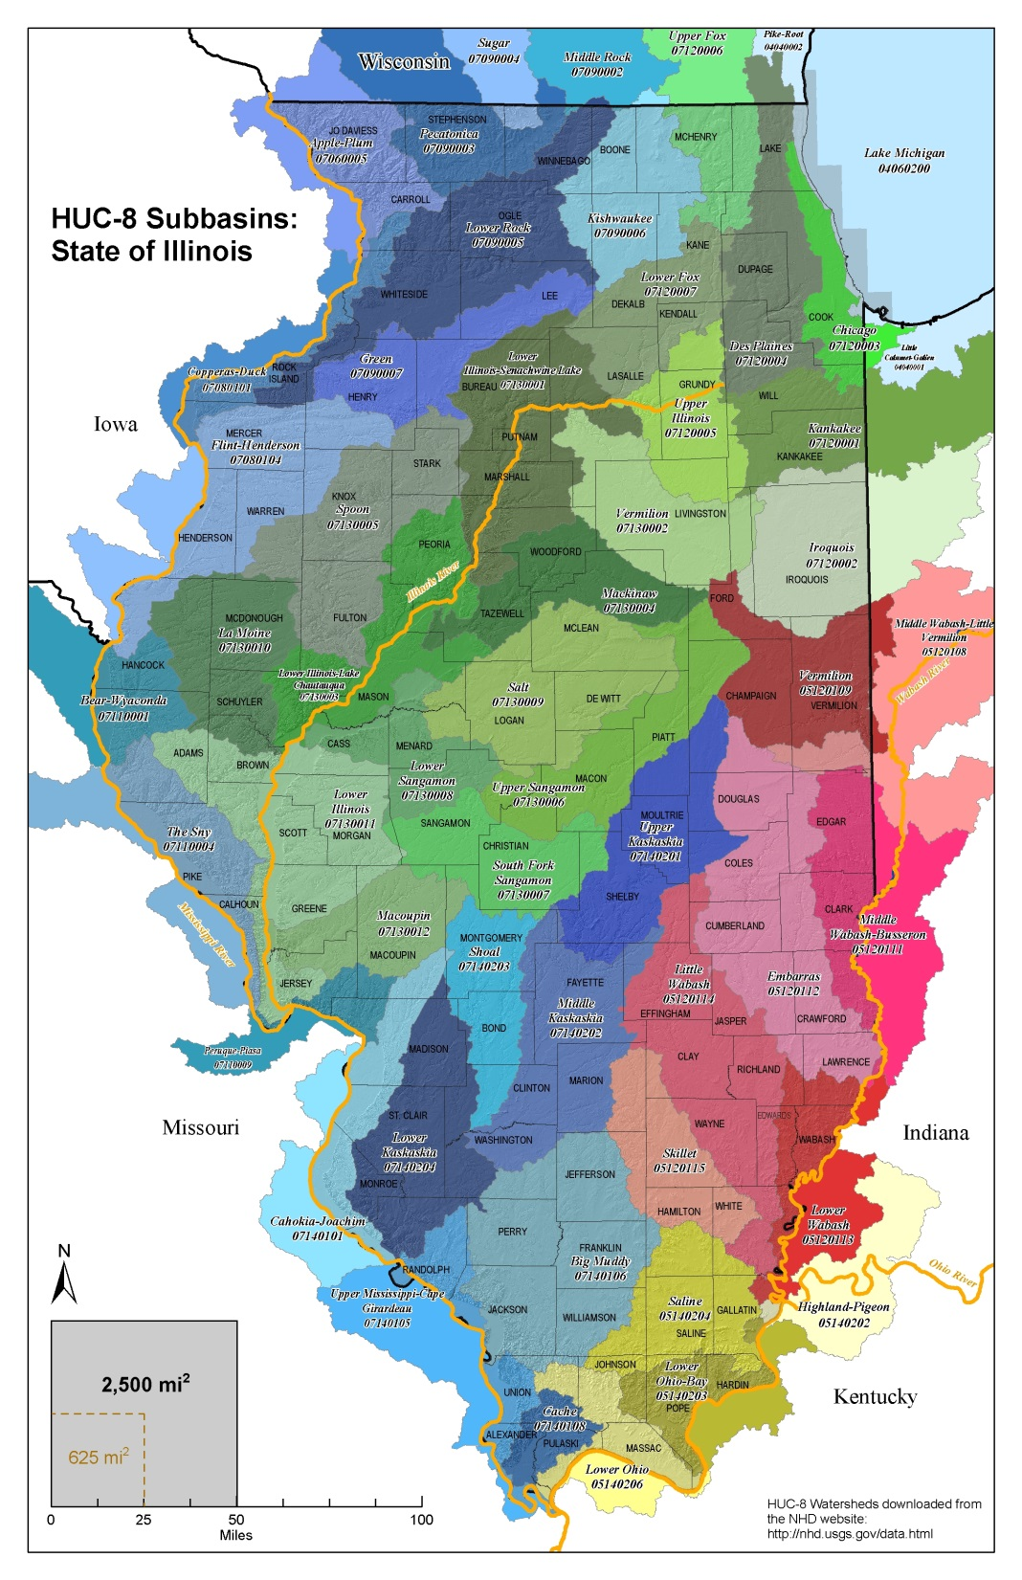

Slide 29
3. Estimate Potential Reductions and Costs
estimate field-level effectiveness of various agricultural management practices
  utilize SAB, Iowa, and Lake Bloomington Project estimates
  knowledge in Illinois
determine possible point source reductions
estimate costs
  Gary Schnitkey (agricultural economist) will lead
  initial investments
  likely to annualize costs over 25 years

Slide 30
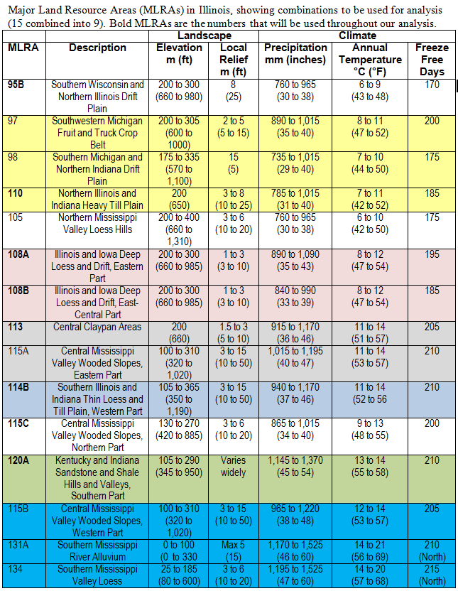
Combined MLRA’s

Slide 31
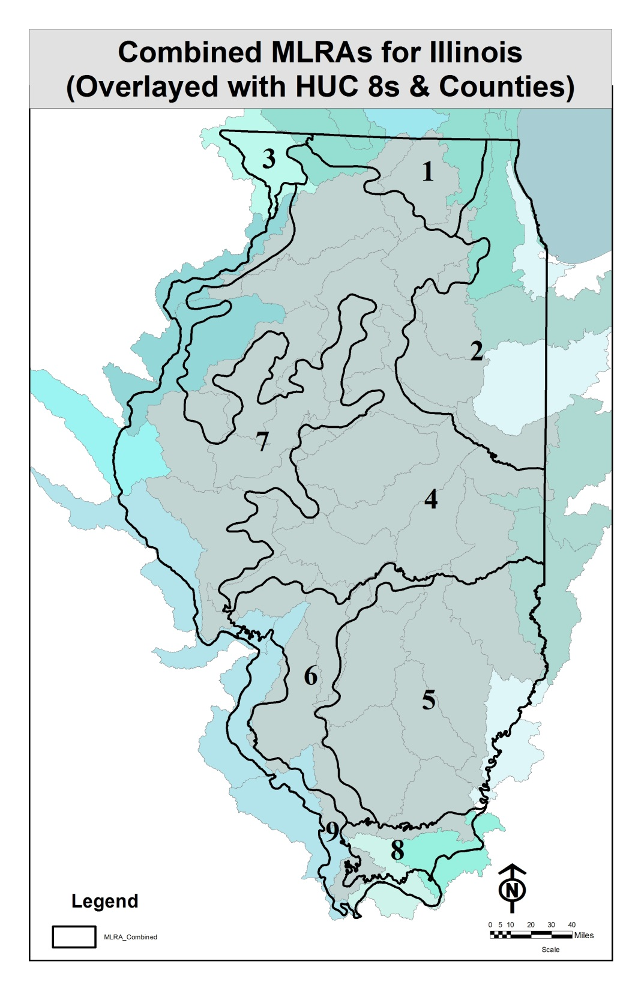

Slide 32
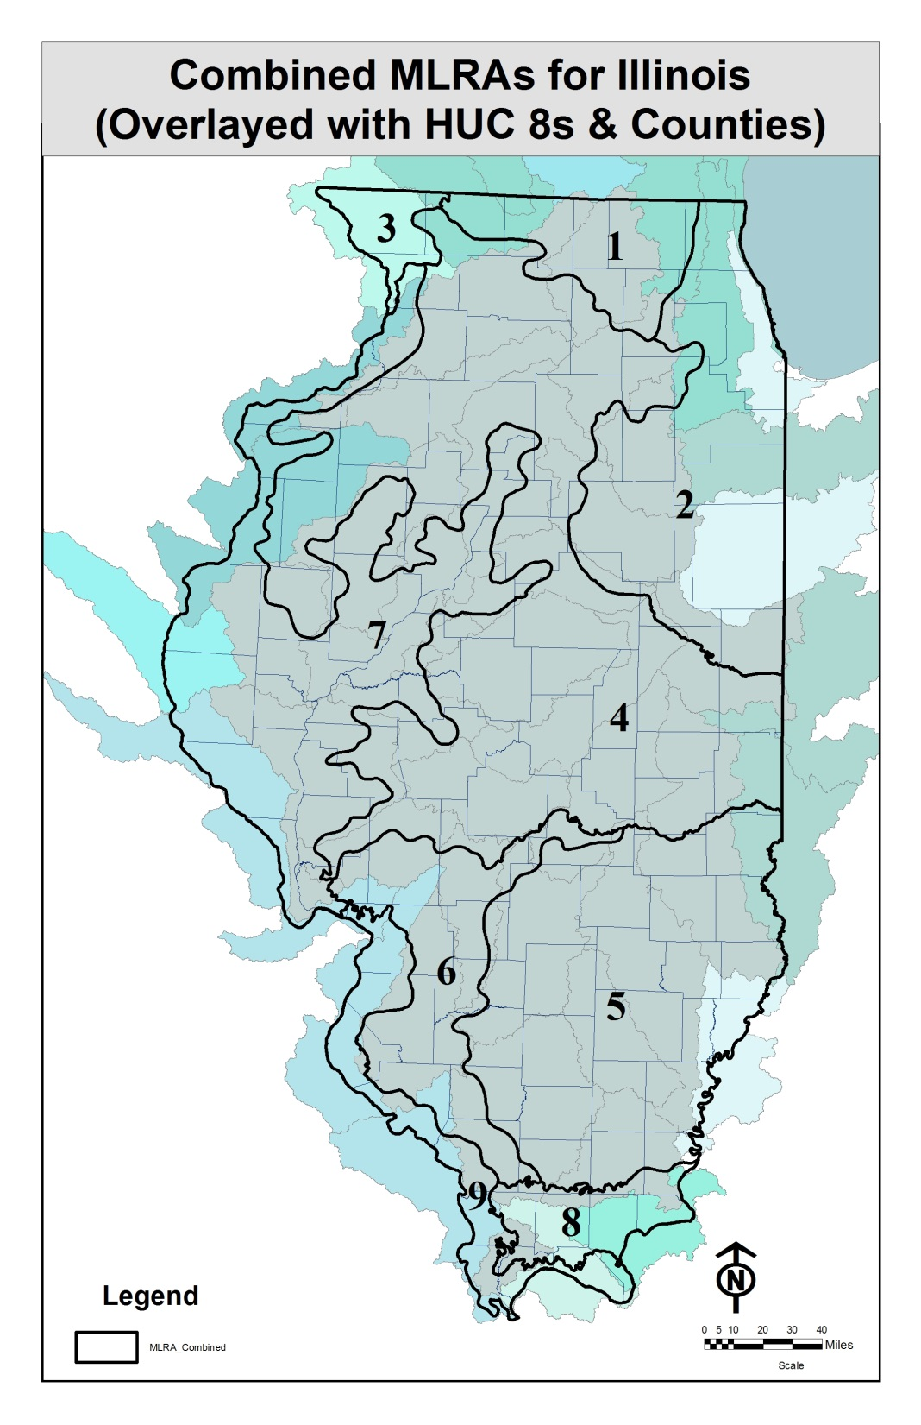

Slide 33
Agricultural Management by MLRA
Combined MLRA | Description | Corn (acres) | Soybean (acres) | Wheat (acres) | Drained acres (% of crop acres) | Corn yield (bushels/acre) | Soybean yield (bushels/acre)
MLRA 1 | Northern Illinois drift plain | 515,905 | 224,186 | 20,192 | 288,491 (39) | 161 | 48
MLRA 2 | Northeastern Illinois heavy till plain | 1,532,100 | 1,111,885 | 42,404 | 2,063,695 (78) | 150 | 39
MLRA 3 | Northern Mississippi Valley | 163,507 | 52,432 | 1,975 | 20,942 (10) | 160 | 50
MLRA 4 | Deep loess and drift | 5,579,980 | 3,343,444 | 76,078 | 5,437,807 (61) | 164 | 52
MLRA 5 | Claypan | 1,609,633 | 1,991,939 | 352,839 | 310,087 (9) | 128 | 39
MLRA 6 | Thin loess and till | 664,242 | 689,773 | 161,180 | 226,971 (17) | 130 | 42
MLRA 7 | Central Mississippi Valley, Northern Part | 2,058,853 | 1,288,686 | 73,884 | 1,284,588 (38) | 155 | 49
MLRA 8 | Sandstone and shale hills and valleys | 83,969 | 115,244 | 10,658 | 49,565 (25) | 103 | 33
MLRA 9 | Central Mississippi Valley, Western Part | 203,736 | 314,662 | 78,250 | 23,769 (5) | 125 | 39
Sum |  | 12,411,925 | 9,132,251 | 817,460 | 9,705,916 (43)
Average crop acres and yields 2008 through 2012

Slide 34
Agricultural Management by MLRA
Combined MLRA | Description | Estimated corn fertilizer (lbs N/acre/yr) | Estimated corn fertilizer + manure (lbs N/acre/yr) | Row crops (acres) | Nitrate-N yield per row crop acre (lbs N/acre/yr)
MLRA 1 | Northern Illinois drift plain | 152 | 168 | 760,283 | 20.4
MLRA 2 | Northeastern Illinois heavy till plain | 158 | 164 | 2,686,389 | 25.0
MLRA 3 | Northern Mississippi Valley | 135 | 158 | 217,914 | 31.3
MLRA 4 | Deep loess and drift | 150 | 159 | 8,999,502 | 19.6
MLRA 5 | Claypan | 180 | 196 | 3,954,411 | 6.6
MLRA 6 | Thin loess and till | 156 | 170 | 1,515,195 | 7.4
MLRA 7 | Central Mississippi Valley, Northern Part | 155 | 169 | 3,421,423 | 24.5
MLRA 8 | Sandstone and shale hills and valleys | 209 | 219 | 209,871 | 3.9
MLRA 9 | Central Mississippi Valley, Western Part | 192 | 204 | 596,648 | 4.0
Sum |  | 157 | 168 | 22,361,636

Slide 35
Agricultural Management by MLRA
Combined MLRA | Description | Estimated Corn fertilizer (lbs N/acre/yr) | Estimated Corn fertilizer + manure (lbs N/acre/yr) | Row crops (acres) | Nitrate-N yield per row crop acre (lbs N/acre/yr)
MLRA 1 | Northern Illinois drift plain | 152 | 168 | 760,283 | 20.4
MLRA 2 | Northeastern Illinois heavy till plain | 158 | 164 | 2,686,389 | 25.0
MLRA 3 | Northern Mississippi Valley | 135 | 158 | 217,914 | 31.3
MLRA 4 | Deep loess and drift | 150 | 159 | 8,999,502 | 19.6
MLRA 5 | Claypan | 180 | 196 | 3,954,411 | 6.6
MLRA 6 | Thin loess and till | 156 | 170 | 1,515,195 | 7.4
MLRA 7 | Central Mississippi Valley, Northern Part | 155 | 169 | 3,421,423 | 24.5
MLRA 8 | Sandstone and shale hills and valleys | 209 | 219 | 209,871 | 3.9
MLRA 9 | Central Mississippi Valley, Western Part | 192 | 204 | 596,648 | 4.0
Sum |  | 157 | 168 | 22,361,636

Slide 36
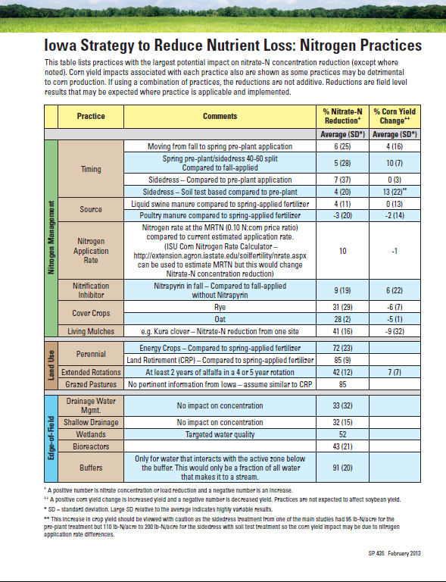
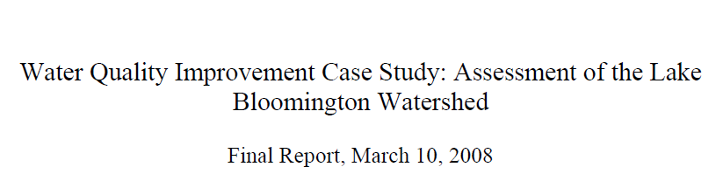
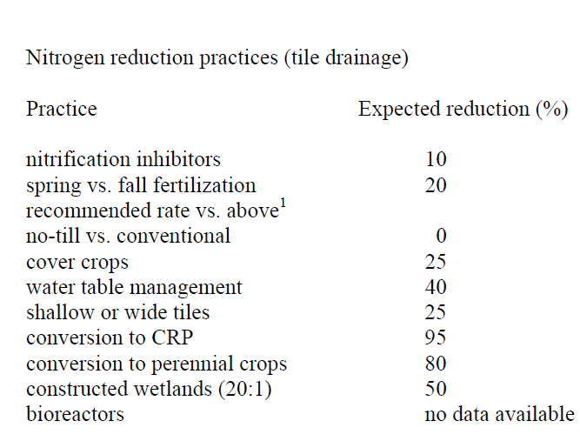

Slide 37
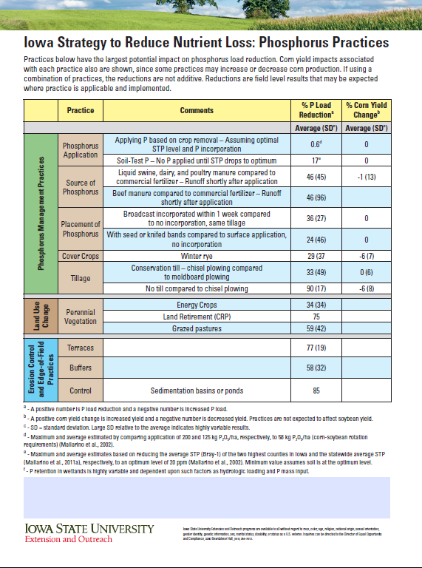
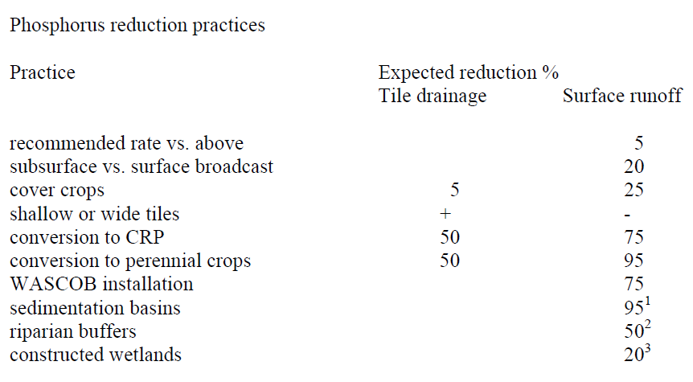

Slide 38
4. Develop Scenarios
combine possible point source reductions and field level agricultural reductions
  percent reduction by practice
  costs of implementation
  target 45% reductions in N and P
scale-up to critical watersheds and statewide
provide a range of scenarios to meet reduction targets
  area needed by practice
  initial investment and annualized costs

